Slide 1
Operating Systems
Practical Session 11
File Systems
1

Slide 2
File Systems
Control how data is stored and retrieved
Different types:
NTFS [1,2] (modern windows)
FAT [16,32] (old windows and dos)
EXT [2,3,4] (unix)
Etc.
2

Slide 3
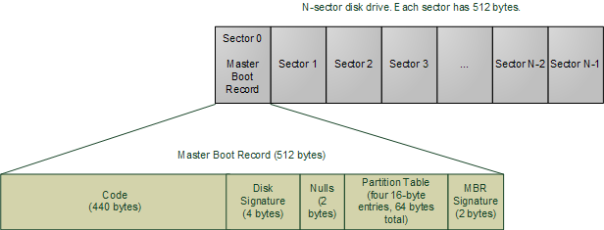
MBR – Master Boot Record
The MBR is a record located on the first sector of the disk.
It contains the information on how the logical partitions and containing file systems are organized on that disk.
3
Notes:
Unix like file system.
3

Slide 4
MBR – Boot Loader
The MBR also contains the boot loader executable code. When the PC starts the BIOS load the boot loader of the selected disk into the memory and execute it.
This code may serve as a loader for the installed operating system
usually since a sector size is only 512b and the MBR must take only 1 sector, the loader may load and pass control over to a second stage loader located elsewhere.
4
Notes:
Unix like file system.
4

Slide 5
MBR – Partition Table
Finally, the MBR also contains the partition table
Partitions are logical splits of the disk
Each partition can contain its own file system that will manage the files stored on this partition.
5
Notes:
Unix like file system.
5

Slide 6
The Ext File system – inode based
Keep records on files using a data structure called inode.
A Directory is also a file
Each inode keeps a metadata representing a single file
Common on unix like operating systems
The file-system metadata is located on a special block called the superblock and may span additional blocks
6
Notes:
Unix like file system.
6

Slide 7
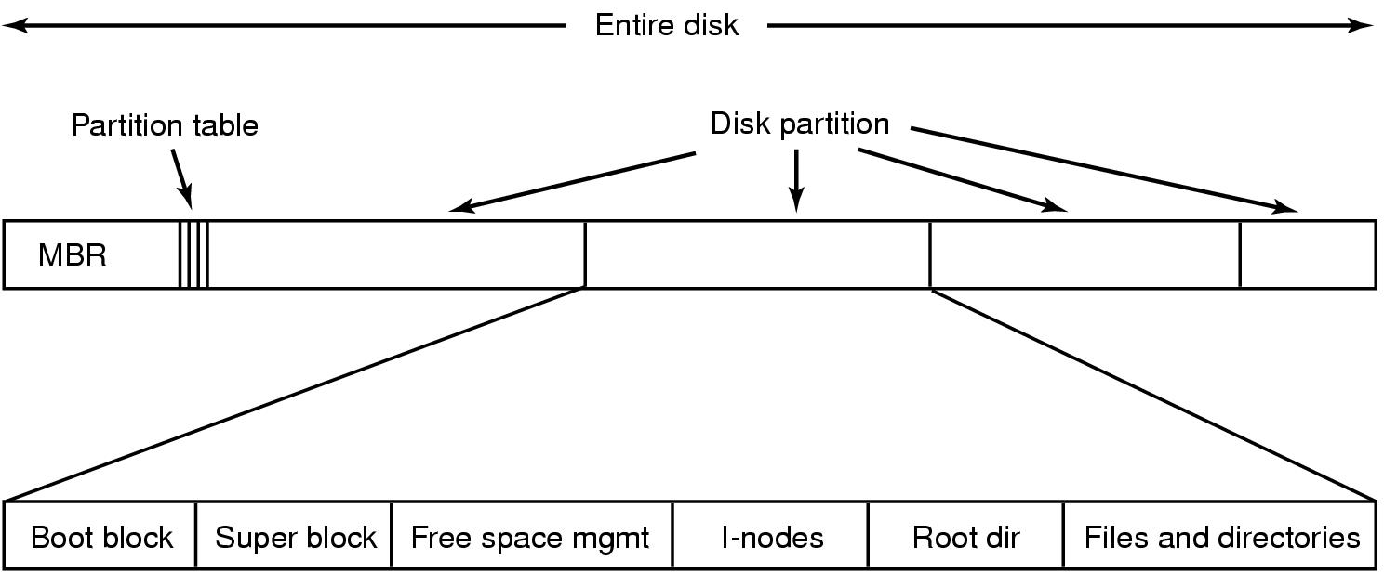
Ext File system layout – inode based (Tanenbaum)
7
Notes:
Unix like file system.
Boot Block: located in the first few sectors of a file system. The boot block contains the initial bootstrap program used to load the operating system. Typically, the first sector contains a bootstrap program that reads in a larger bootstrap program from the next few sectors, and so forth.
7

Slide 8
What is an inode
An inode is a structure on the disk that represents a file, directory, symbolic link, etc.
inodes do not contain the data of the file / directory / etc. that they represent.
they link to the blocks that actually contain the data.
The inodes themselves have a well-defined size which lets them be placed in easily indexed arrays.
8
Notes:
Unix like file system.
8

Slide 9
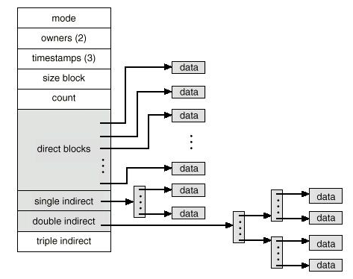
Index-Nodes (i-nodes)
General file attributes
File Size
HardLink count
The number of hard-links to the file
Usually between 10 and 12
9
Notes:
File owner identifier: Ownership is divided between an individual owner and a "group" owner and defines the set of users who have access rights to a file. The superuser has access rights to all files in the system.
File type: Files may be regular, directory, character or block special.
File access permissions :
File access times: giving the time the file was last modified, when it was last accessed, and when the inode was last modified.
Number of links to the file: representing the number of names the file has in the directory hierarchy.
Table of contents for the disk addresses of data in a file. Although users treat the data in a file as a logical stream of bytes, the kernel saves the data in discontiguous disk blocks. The inode identifies the disk blocks that contain the file's data.
File size. Data in a file is addressable by the number of bytes from the beginning of the file, starting from byte offset 0, and the file size is 1 greater than the highest byte offset of data in the file.
The inode does not specify the path name(s) that access the file.
9

Slide 10
Directories
Each directory is a list of directory entries.
Each directory entry associates one file name with one inode number
To find a file, the directory entry is searched for the associated filename.
The root directory is always stored in inode number two, so that the file system code can find it at mount time.
10

Slide 11
Directories
The special directories "." (current directory) and ".." (parent directory) are implemented by storing the names "." and ".." in the directory, and the inode number of the current and parent directories in the inode field.
The only special treatment these two entries receive is that they are automatically created when any new directory is made, and they cannot be deleted.
11

Slide 12
XV6

Slide 13
Layers
File descriptor | Process
Pathname | Lookup
Directory
Inode | File System
Logging (Journaling)
Buffer cache | Cache
Disk | Hardware
13
Notes:
xv6 only one device (ROOTDEV)
Only single device (major) – console
When accessing a device file, the major number selects which device driver is being called to perform the input/output operation. This call is being done with the minor number as a parameter and it is entirely up to the driver how the minor number is being interpreted. The driver documentation usually describes how the driver uses minor numbers.
13

Slide 14
File descriptor (file.h)
struct file {
enum { FD_NONE, FD_PIPE, FD_INODE } type;
int ref; // reference count
char readable;
char writable;
struct pipe *pipe;
struct inode *ip;
uint off;
};
struct {
struct spinlock lock;
struct file file[NFILE];
} ftable;
14
Notes:
// On-disk file system format.
// Both the kernel and user programs use this header file.
// Block 0 is unused.
// Block 1 is super block.
// Blocks 2 through sb.ninodes/IPB hold inodes.
// Then free bitmap blocks holding sb.size bits.
// Then sb.nblocks data blocks.
// Then sb.nlog log blocks.
14

Slide 15
File descriptor (file.c)
// Allocate a file structure.
struct file*
filealloc(void)
{
struct file *f;
acquire(&ftable.lock);
for(f = ftable.file; f < ftable.file + NFILE; f++){
if(f->ref == 0){
f->ref = 1;
release(&ftable.lock);
return f;
}
}
release(&ftable.lock);
return 0;
}
// Increment ref count for file f.
struct file*
filedup(struct file *f)
{
acquire(&ftable.lock);
if(f->ref < 1)
panic("filedup");
f->ref++;
release(&ftable.lock);
return f;
}
15
Notes:
// On-disk file system format.
// Both the kernel and user programs use this header file.
// Block 0 is unused.
// Block 1 is super block.
// Blocks 2 through sb.ninodes/IPB hold inodes.
// Then free bitmap blocks holding sb.size bits.
// Then sb.nblocks data blocks.
// Then sb.nlog log blocks.
15

Slide 16
Inodes (file.h) and Dinode (fs.h)
// in-memory copy of an inode
struct inode {
uint dev; // Device number
uint inum; // Inode number
int ref; // Reference count
int flags; // I_BUSY, I_VALID
short type; // copy of disk inode
short major;
short minor;
short nlink;
uint size;
uint addrs[NDIRECT+1];
};
// On-disk inode structure
struct dinode {
// File type
short type;
// Major device number (T_DEV only)
short major;
// Minor device number (T_DEV only)
short minor;
// Number of links to inode in file system
short nlink;
// Size of file (bytes)
uint size;
// Data block addresses
uint addrs[NDIRECT+1];
};
16
Notes:
xv6 only one device (ROOTDEV)
Only single device (major) – console
When accessing a device file, the major number selects which device driver is being called to perform the input/output operation. This call is being done with the minor number as a parameter and it is entirely up to the driver how the minor number is being interpreted. The driver documentation usually describes how the driver uses minor numbers.
16

Slide 17
Block map (fs.c)
return/allocate block position
// Inode content
//
// The content (data) associated with each inode is stored
// in blocks on the disk. The first NDIRECT block numbers
// are listed in ip->addrs[]. The next NINDIRECT blocks are
// listed in block ip->addrs[NDIRECT].
// Return the disk block address of the nth block in inode ip.
// If there is no such block, bmap allocates one.
static uint
bmap(struct inode *ip, uint bn)
{
uint addr, *a;
struct buf *bp;
if(bn < NDIRECT){
if((addr = ip->addrs[bn]) == 0)
ip->addrs[bn] = addr = balloc(ip->dev);
return addr;
}
bn -= NDIRECT;
if(bn < NINDIRECT){
// Load indirect block, allocating if necessary.
if((addr = ip->addrs[NDIRECT]) == 0)
ip->addrs[NDIRECT] = addr = balloc(ip->dev);
bp = bread(ip->dev, addr);
a = (uint*)bp->data;
if((addr = a[bn]) == 0){
a[bn] = addr = balloc(ip->dev);
log_write(bp);
}
brelse(bp);
return addr;
}
panic("bmap: out of range");
}
17
Notes:
xv6 only one device (ROOTDEV)
Only single device (major) – console
When accessing a device file, the major number selects which device driver is being called to perform the input/output operation. This call is being done with the minor number as a parameter and it is entirely up to the driver how the minor number is being interpreted. The driver documentation usually describes how the driver uses minor numbers.
17

Slide 18
Buffer cache (buf.h)
struct buf {
int flags;
uint dev;
uint sector;
struct buf *prev; // LRU cache list
struct buf *next;
struct buf *qnext; // disk queue
uchar data[512];
};
#define B_BUSY 0x1 // buffer is locked by some process
#define B_VALID 0x2 // buffer has been read from disk
#define B_DIRTY 0x4 // buffer needs to be written to disk
struct {
struct spinlock lock;
struct buf buf[NBUF];
// Linked list of all buffers, through prev/next.
// head.next is most recently used.
struct buf head;
} bcache;
18
Notes:
xv6 only one device (ROOTDEV)
Only single device (major) – console
When accessing a device file, the major number selects which device driver is being called to perform the input/output operation. This call is being done with the minor number as a parameter and it is entirely up to the driver how the minor number is being interpreted. The driver documentation usually describes how the driver uses minor numbers.
18

Slide 19
Buffer cache (bio.c)
struct buf* bread(uint dev, uint sector)
{
struct buf *b;
b = bget(dev, sector);
if(!(b->flags & B_VALID))
iderw(b);
return b;
}
void bwrite(struct buf *b)
{
if((b->flags & B_BUSY) == 0)
panic("bwrite");
b->flags |= B_DIRTY;
iderw(b);
}
Synchronize the cached block with the block on disk using IDE driver
19
Notes:
xv6 only one device (ROOTDEV)
Only single device (major) – console
When accessing a device file, the major number selects which device driver is being called to perform the input/output operation. This call is being done with the minor number as a parameter and it is entirely up to the driver how the minor number is being interpreted. The driver documentation usually describes how the driver uses minor numbers.
19

Slide 20
Disk (ide.c)
void
iderw(struct buf *b)
{
struct buf **pp;
if(!(b->flags & B_BUSY))
panic("iderw: buf not busy");
if((b->flags & (B_VALID|B_DIRTY)) == B_VALID)
panic("iderw: nothing to do");
if(b->dev != 0 && !havedisk1)
panic("iderw: ide disk 1 not present");
acquire(&idelock); //DOC:acquire-lock
// Append b to idequeue.
b->qnext = 0;
for(pp=&idequeue; *pp; pp=&(*pp)->qnext);
*pp = b;
// Start disk if necessary.
if(idequeue == b)
idestart(b);
// Wait for request to finish.
while((b->flags & (B_VALID|B_DIRTY)) != B_VALID){
sleep(b, &idelock);
}
release(&idelock);
}
void
ideintr(void)
{
struct buf *b;
// First queued buffer is the active request.
acquire(&idelock);
if((b = idequeue) == 0){
release(&idelock);
// cprintf("spurious IDE interrupt\n");
return;
}
idequeue = b->qnext;
// Read data if needed.
if(!(b->flags & B_DIRTY) && idewait(1) >= 0)
insl(0x1f0, b->data, BSIZE/4);
// Wake process waiting for this buf.
b->flags |= B_VALID;
b->flags &= ~B_DIRTY;
wakeup(b);
// Start disk on next buf in queue.
if(idequeue != 0)
idestart(idequeue);
release(&idelock);
}
20
Notes:
xv6 only one device (ROOTDEV)
Only single device (major) – console
When accessing a device file, the major number selects which device driver is being called to perform the input/output operation. This call is being done with the minor number as a parameter and it is entirely up to the driver how the minor number is being interpreted. The driver documentation usually describes how the driver uses minor numbers.
20

Slide 21
Question 1: i-nodes
How many time will the disk be accessed when a user executes the following command:
more /usr/tmp/a.txt
Assume that:
The size of 'a.txt' is 1 block.
The i-node of the root directory is not in the memory.
Entries 'usr', 'tmp' and 'a.txt' are all located in the first block of their directories.
Ignore the disk access required in order to load more
21

Slide 22
Question 1: answer
Accessing each directory requires at least 2 disk accesses: reading the i-node and the first block.
In our case the entry we are looking for is always in the first block so we need exactly 2 disk accesses.
According to assumption 2 the root directory's i-node is located on the disk so we need 6 disk accesses (3 directories) until we reach a.txt's i-node index.
Since "more" displays the file's content, for a.txt we need its i-node + all the blocks of the file (1 block, according to assumption).
Total disk accesses: 6 + 2 = 8.
22

Slide 23
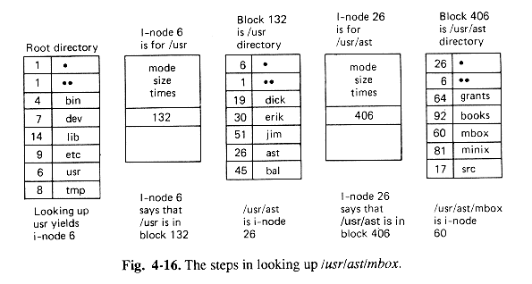
Question 1: i-nodes
A similar problem
23

Slide 24
Question 2: i-nodes
The Ofer2000 Operating Systems, based on UNIX, provides the following system call:
rename(char *old, char *new)
This call changes a file’s name from ‘old’ to ‘new’. What is the difference between using this call, and just copying ‘old’ to a new file, ‘new’, followed by deleting ‘old’? Answer in terms of disk access and allocation.
24

Slide 25
Question 2: i-nodes
rename - simply changes the file name in the entry of its directory.
copy - will allocate a new i-node and the blocks for the new file, and copy the contents of the old file blocks to the new ones.
delete - will release the i-node and blocks of the old file.
copy + delete - is a much more complicated operation for the Operating System, note that you will not be able to execute it if you do not have enough free blocks or i-nodes left on your disk.
25
Notes:
25

Slide 26
Question 3: i-nodes
Write an implementation (pseudo code) of the system call:
delete(i-node node)
Which deletes the file associated with node.
Assume that:
node is associated with a regular file, and that delete is not recursive.
The i-node has 10 direct block entries, 1 single indirect entry and 1 double indirect entry.
You may use the system calls:
read_block(block b) which reads block b from the disk.
free_block(block b) and free_i-node(i-node node).
26
Notes:
Should check number of Hard Links first
26

Slide 27
Question 3: i-nodes
delete(i-node node){
// remove the direct blocks
for each block b in node.direct do
free_block(b);
// remove the single indirect blocks
single <-- read_block(node.single_indirect)
for each entry e in single do
free_block(e);
free_block(single);
// remove the double indirect blocks
double <-- read_block(node.double_indirect)
for each entry e in double do
single <-- read_block(e)
for each entry ee in single do
free_block(ee);
free_block(single);
free_block(double);
// remove the i-node
free_i-node(node);
}
27

Slide 28
Question 3: i-nodes
What would be the maximal size of a file in a UNIX system with an address size of 32 bits if :
The block size is 1K
The block size is 4K
The i-node has 10 direct block entries,
single, double & triple indirect
28

Slide 29
Question 3: i-nodes
Block size: 1K
Direct: 10·1K
Single indirect: each address is 32 bit = 4 byte then we have 256 pointers to blocks of size 1K (i.e. 256·1K)
The same idea is applied for double and triple indirect.
In total:
10·1K+256·1K+256·256·1K+256·256·256·1K
~= 16G
29

Slide 30
Question 3: i-nodes
Block size: 4K
Direct: 10·4K
Single indirect: each address is 32 bit = 4 byte then we have 1024 pointers to blocks of size 4K (i.e. 1024·4K)
The same idea is applied for double and triple indirect
In total: 10·4K+1024·4K+1024·1024·4K+1024·1024·1024·4K
~= 4T
30

Slide 31
Question 4: i-nodes
Assuming that the size of each block is 1K and the address size is 32 bits (4 bytes). Convert byte address (offset) 1,515,000 in our file to the physical address. (Block map)
31

Slide 32
Question 5: I-Nodes
Byte number 1,515,000 is calculated as follows:
1st byte of the double indirect block is 10k+256k = 272,384
byte number 1,515,000 is number 1,242,616 in the double indirect block
every single indirect block has 256k bytes --> byte 1,242,616 is in the 5th single indirect block (4*256k = 1,048,576)
Every entry is 1k, so byte 194,040 is in the 190th block – assume that it points to block 123 on the disk
within block 123 , it is byte #504
32

